Slide 1
Junction Tree Variational Autoencoder (JTVAE)
Basic goal:
Turn this into...
Vector...
So we can do math on molecules
a₁
a₂
.
.
.
a_{i}
.
.
.
f(A) = Property (emission λ )
* Use math to find B
f(B) = Better property (longer λ)
A =
A
Emission λ = 417 nm
Goal is to design similar molecule that emits in near-IR region for in vivo research * But using AI
B
Emission λ = 740 nm (Near-Infrared)
Chem. Sci. (2020)

Slide 2
Junction Tree Variational Autoencoder (JTVAE)
Basic goal:
Turn this into...
Vector...
So we can do math on molecules
a₁
a₂
.
.
.
a_{i}
.
.
.
f(A) = Property (emission λ )
* Use math to find B
f(B) = Better property (longer λ)
A =
A
Emission λ = 417 nm
Probably many ways to do this,
including as-yet undiscovered methods?
Most successful methods to date rely on
Autoencoders trained by Machine Learning.
B
Emission λ = 740 nm (Near-Infrared)
Chem. Sci. (2020)

Slide 3
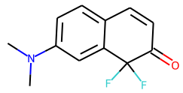
Junction Tree Variational Autoencoder (JTVAE)
CN(C)c1ccc2c(c1)C(F)(F)C(=O)C=C2 (SMILES string)
6
10
5
7
11
1
4
12
8
13
3
14
9
2
16
15
Graph (in terms of atoms)
C C N C C C C C C C C C C O F F
C 1
C 1
N 1 1 1
C 1 2 1
C 2 1
C 1 2
C 2 1 1
C 1 1 1
C 1 1
C 1 2
C 2 1
C 1 1 2
C 1 1 1 1
O 2
F 1
F 1

Slide 4
Junction Tree Variational Autoencoder (JTVAE)
CN(C)c1ccc2c(c1)C(F)(F)C(=O)C=C2
Junction Tree
Clusters
6
10
5
6
1. Bonds
2. Rings
3. Atoms joined to
≥ 3 bonds/rings
5
7
11
1
4
1
4
12
8
7
8
13
3
3
14
10
9
9
2
2
16
15
Graph (in terms of atoms)
Tree (in terms of clusters)
C C N C C C C C C C C C C O F F
C 1
C 1
N 1 1 1
C 1 2 1
C 2 1
C 1 2
C 2 1 1
C 1 1 1
C 1 1
C 1 2
C 2 1
C 1 1 2
C 1 1 1 1
O 2
F 1
F 1
Vocabulary (clusters)
V₁ = C1–N3
V₂ = C2–N3
V₃ = N3-C4
V₄ = N3
V₅ = C4C5C6C7C8C9
V₆ = C7C10C11C12C13C8
V₇ = C12=O14
V₈ = C13
V₉ = C13-F15
V₁₀ = C13-F16
1 2 3 4 5 6 7 8 9 10
1 1 1 ∞
2 1 1 ∞
3 1 1 ∞ 1
4 ∞ ∞ ∞
5 1 1
6 1 1 ∞ 1 1
7 1
8 ∞ ∞ ∞
9 1 ∞ 1
10 1 ∞ 1

Slide 5
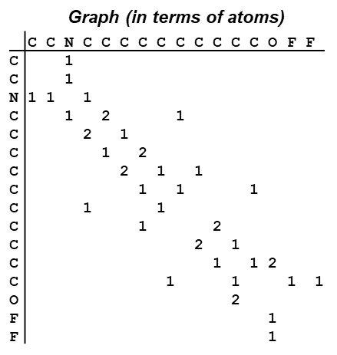
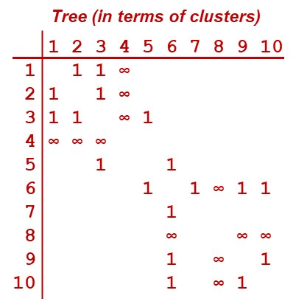
Junction Tree Variational Autoencoder (JTVAE)
Latent Vectors
G
Weights
z_{G}
Message Passing NN
+ other data
Encoding
* complex! *
T
Weights
z_{T}
Message Passing NN

Slide 6
Junction Tree Variational Autoencoder (JTVAE)
Latent Vectors
G
Weights
z_{G}
Message Passing NN
+ other data
Encoding
* complex! *
Decoding
* complex! *
T
Parameters
Weights
T’
z_{T}
Build T’ one node/cluster
at a time with each
step maximizing
<z_{T} | z_{T’}>
Message Passing NN

Slide 7
Junction Tree Variational Autoencoder (JTVAE)
Latent Vectors
G
G’
Weights
z_{G}
Message Passing NN
+ other data
Parameters
Encoding
* complex! *
Build G’ from T’
each step maximizing
<z_{G} | z_{G’}>
T
Parameters
Weights
T’
z_{T}
Build T’ one node/cluster
at a time with each
step maximizing
<z_{T} | z_{T’}>
Message Passing NN

Slide 8
Junction Tree Variational Autoencoder (JTVAE)
Latent Vectors
G
Model/parameters trained
by maximizing
<G|G’>
&
<T|T’>
via Deep Learning
G’
Weights
z_{G}
Message Passing NN
+ other data
Parameters
Encoding
* complex! *
Build G’ from T’
each step maximizing
<z_{G} | z_{G’}>
T
Parameters
Weights
T’
z_{T}
Build T’ one node/cluster
at a time with each
step maximizing
<z_{T} | z_{T’}>
Message Passing NN

Slide 9
Junction Tree Variational Autoencoder (JTVAE)
Another way to look at this
G
Given Z_{G} find
G’ → z_{G’} = z_{G}
For training set we know how
G → z_{G} so we can try to train Model to help.
Of course, we can also test every possible G’ in Universe until we find z_{G} = z_{G’}
Weights/Parameters
G’
Don’t know this
z_{G}
Message Passing NN

Slide 10
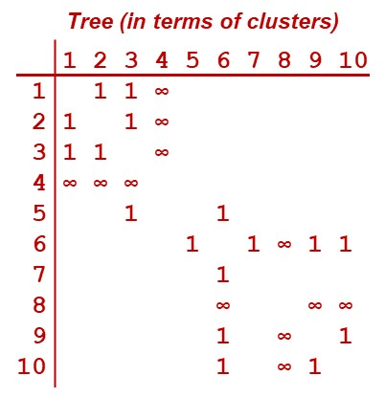
Junction Tree Variational Autoencoder (JTVAE)
Another way to look at this
G
Given Z_{G} find
G’ → z_{G’} = z_{G}
For training set we know how
G → z_{G} so we can try to train Model to help.
Of course, we can also test every possible G’ in Universe until we find z_{G} = z_{G’}
JTVAE uses graph of clusters
to help. Very impressive! Years ahead of its time.
Weights/Parameters
G’
Don’t know this
z_{G}
Message Passing NN
T
Weights/Parameters
T’
z_{T}
Message passing NN

Slide 11
JTVAE Steps/Components – Original and Fast (New)
Vocabulary Determination: Determines functional units for Junction Tree (not Graph)
Original/Slow-JTVAE
Pretrain: 3 epochs, specific deep learning parameters
Final Train: 7 epochs, different deep learning parameters
Reconstruction evaluation: Code/script available
Use Autoencoder for molecule optimization
New/Fast-JTVAE
Preprocess: Process molecules, store batch data on disk
Training: Recommended learning parameters given
Reconstruction evaluation
Use Autoencoder for molecule optimization
All codes/scripts provided.
Implemented on CPU & GPU
Provided but significant
debugging/modification
had to be done: CPU & GPU
Nothing available/provided.
Had to code own Reconstruction evaluation program. Encountered significant issues.
* Code now robust, parallel, and fast.
Nothing available/provided for this

Slide 12
JTVAE Vocabulary Determination Times
ZINC Dataset : 250 K molecules, same as described in paper
Moses Dataset: 1.6 M molecules
MOSES
CPU: Orig-JTVAE
CPU: Fast-JTVAE
GPU: Fast-JTVAE
Time (hours)
← ZINC
Number of molecules

Slide 13
JTVAE Preprocessing Times: Only for Fast (New)
ZINC Dataset : 250 K molecules, same as described in paper
Moses Dataset: 1.6 M molecules
Fast-JTVAE: Preprocessing
GPU slower
CPU fastest
Time (hours)

Slide 14
JTVAE Model Training Times: Original vs. Fast (New)
ZINC Dataset : 250 K molecules, same as described in paper
Original-JTVAE
(3 epochs pretrain (red) + 20 epochs train)
Fast-JTVAE
(20 epochs train)
Time (Days)
GPU fastest
GPU fastest
Only feasible way
to use JTVAE

Slide 15
JTVAE Reconstruction Timings: Original vs. Fast (New)
ZINC Dataset : 5 K Test molecules, same as described in paper
Original-JTVAE
Encode 10 x → Decode 10 x = 100 reconstructs.
Only encoding is stochastic, but Stereoisomerism
accounting re-encodes candidate molecules.
Fast-JTVAE
Encode 10 x → Decode 1 = 10 reconstructs.
No Stereoisomerism in new method.
Time (hours)
Time (mins)
CPU runs faster

Slide 16
Fast-JTVAE: Steps and Architecture
Vocabulary Determination: Single Core / no Cuda – CPU or GPU
Preprocessing: CPU – all cores on a node (36 on FRCE)
Model Training: GPU (single card)
Reconstruction Evaluation: CPU – all cores on a node (36)

Slide 17
JTVAE Model Training Quality: Original vs. Fast (New)
ZINC Dataset : 250 K molecules, same as described in paper
Original-JTVAE: Can reproduce result in Paper – 76 % reconstruction
Had to do restarts as runs were killed
Original: Default parameters
Latent Vector size = 56 (as in paper)
76 % = Paper
Reconstruction accuracy (%) [5 K Test set]
epoch

Slide 18
JTVAE Model Training Quality: Original vs. Fast (New)
ZINC Dataset : 250 K molecules, same as described in paper
Fast-JTVAE: Performance not as good as original – 65 % (same as LLNL?)
Used default DL parameters as suggested in Github – Repeat Run same result
Original: Default parameters
Latent Vector size = 56 (as in paper)
76 % = Paper
Reconstruction accuracy (%) [5 K Test set]
Fast: Using suggested/default parameters
* Repeat Run shows reproducibility!
* 65 % - Not as good as Original.
Surmised this was because Original
includes Stereoisomerism/chirality in
atom features.
epoch

Slide 19
JTVAE Model Training Quality: Original vs. Fast (New)
Fast-JTVAE: Improve Model/Autoencoder via machine learning parameters?
Reprogrammed training steps/iterations, added parsed arguments/options
Default(ish) in red – note that in default process beta increases by 0.005 every 2000 iters
* Discovered that keeping beta constant seemed to work better
Best in blue or underline so far…
Number of “warmup” epochs --- 0 3
Learning rate (starting) --- 0.0001 0.0005 0.0007 0.001 0.002 0.01
Anneal rate --- 0.8 0.85 0.9 0.95 1
Minimum learning rate --- 0 0.0001 0.0002
Beta --- 0 0.0025 0.005 0.0055 0.006 0.0075 0.01
Latent Vector Dimension --- 56 72 88 128 256
Hidden size --- 450 600 1000
Graph Depth 3 6

Slide 20
JTVAE Model Training Quality: Original vs. Fast (New)
Fast-JTVAE: Improve Model/Autoencoder via machine learning parameters?
Over 40 Model training runs (~35 hours each, not all shown)…
Reconstruction accuracy (%) [5 K Test set]
So how do we do?????
epoch

Slide 21
JTVAE Model Training Quality: Original vs. Fast (New)
ZINC Dataset : 250 K molecules, same as described in paper
Best so far: Improved Model → 87%, could get teeny bit more maybe…
Prior validity = 100% | Always gives valid molecules
- Latent Vector size = 128
- Learning Rate = 0.0007
- Anneal Rate = 0.9
- 3 epochs no regularization
- Then regularization (β = 0.006)
Fast: Improved - 87%, still running…
Original: Default parameters
Latent Vector size = 56 (as in paper)
76 % = Paper
Reconstruction accuracy (%) [5 K Test set]
Fast: Using suggested parameters
* Repeat Run shows reproducibility!
* 65 % - Not as good as Original.
Surmised this was because Original
includes Stereoisomerism/chirality in
atom features.
epoch

Slide 22
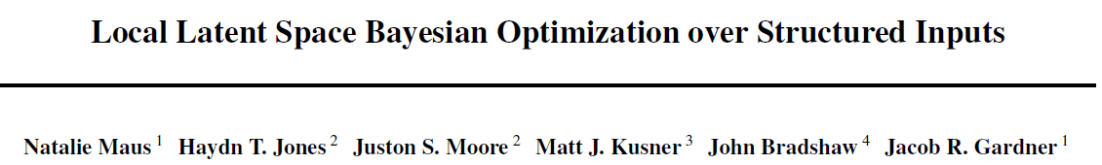
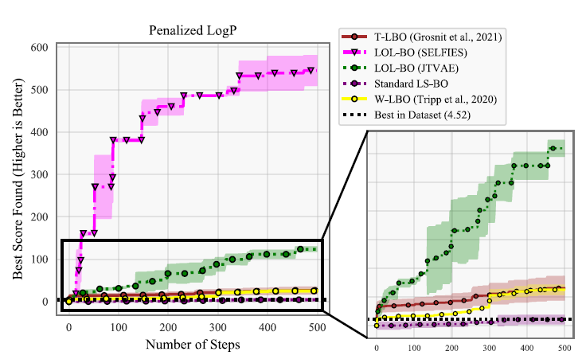
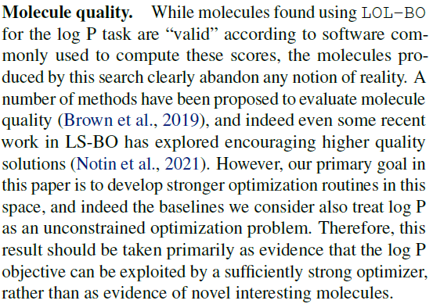
JTVAE / GMD : Next step – molecule optimization
Next step is to combine with molecule optimization method
Researched recent papers describing such methods
Many claim to be superior to previous methods, but results misleading:
LOL-BO (2022)
…molecules produced…abandon any notion of reality.
…this result should be taken as…
rather than as evidence of novel
interesting molecules.
Ours
86 % Recon
LOL-BO (JTVAE)
76 % Recon

Slide 23
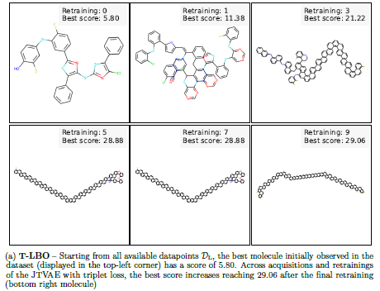
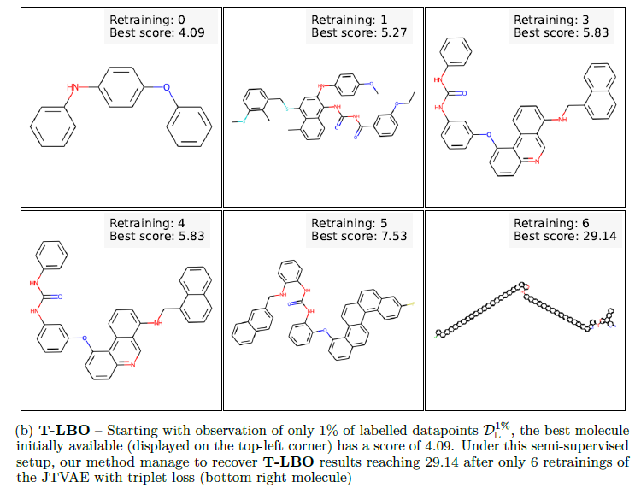
JTVAE / GMD : Next step – molecule optimization
T-LBO (Nov, 2021)
High-Dimensional Bayesian Optimisation with Variational Autoencoders and Deep Learning Metric - Many people at Huawei
Just generates longer and longer chains?
Penalized logP (octanol-water partition coefficients)

Slide 24
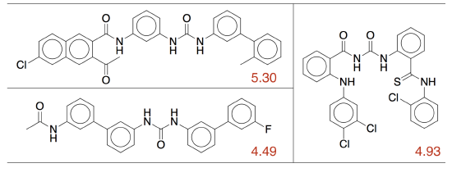
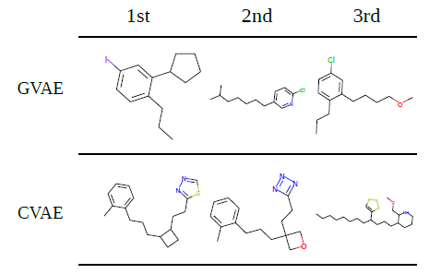
JTVAE / GMD : Next step – molecule optimization
T-LBO (Nov, 2021)
High-Dimensional Bayesian Optimisation with Variational Autoencoders and Deep Learning Metric - Many people at Huawei
Just generates longer and longer chains?
Original JT-VAE paper
Penalized logP (octanol-water partition coefficients)
Grammar-VAE
Character-VAE

Slide 25
JTVAE / GMD : Next step – molecule optimization
Fast-JTVAE Method implemented and refined for best Autoencoding
Next step is to combine with molecule optimization method
Many claim to be superior to previous methods, but results misleading
Most applied to “toy” problems or same datasets (Zinc), few explore “new research”
What are the main differences in methods?
Type of autoencoder used
Type of chemical representation used – SMILES, SELFIES, Graph, (Tree – JTVAE)
How autoencoder is trained/used, e.g., weight input molecules by their property
Weighted Training Datasets (Tripp, et al. → Byung-Jun, et al.)
Modified Fast-JTVAE to replicate (backwards compatible) Old/Original-JTVAE
* No Reconstruction Evaluations for trained/updated Models
Add weights for molecules during autoencoding training
Start with Original-JTVAE Trained Model for Zinc database (on Github) + epoch(s)
But what if your autoencoder is already good?
E.g., 100 % reconstruction accuracy means no need for weighting?

Slide 26
JTVAE / GMD : Next step – molecule optimization
Difficult to identify a molecular optimization method that:
1. Hasn’t only been used on “toy” problems
2. Explores diversity of chemical space vs. only in region of 1-few molecules
3. Is applicable to range of chemical properties
- Fluorescence (absorbance/emission energies/wavelengths) | Test project
- Reaction barriers (transition state energies)
- Acidity (pKa)
- Solubility
- Protein Binding/Docking | Anticipate this to be a focus
- Other?
When you read enough papers, all roads seem to lead to BO
“Regular Bayesian Optimization” main method used for optimization in latent space
Working now to combine with Fast-JTVAE – this wasn’t done in Github

Slide 27
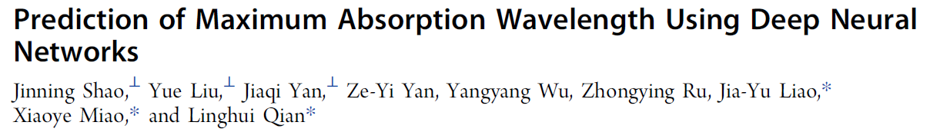

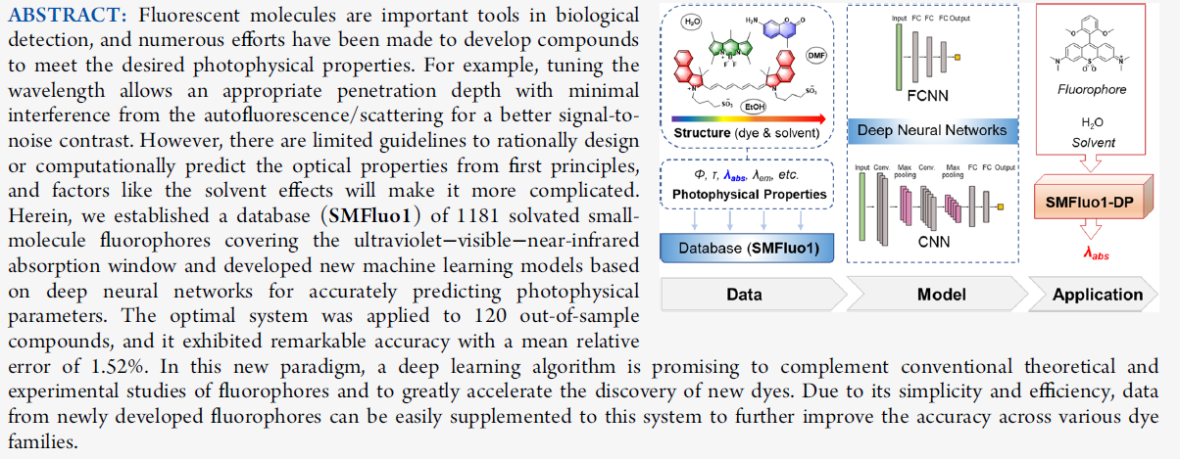
ATOM for Real Chemistry Design – With NCI
NCI Group found and shared publication below:
NCI group has collated small library of near-infrared dyes that we
“…can definitely use to train your program.”
This is perfect research application, in chemical design, for initial AMPL modeling
Could do with some help on this…

